Slide 1
Week - 7
Presented by:
Shafin Bin Hamid
Lecturer
Department of Electrical and Electronics Engineering
Bangladesh University of Engineering and Technology

Slide 2
Outline
Apparent power
Complex power
Conservation of AC power
Power factor correction

Slide 3

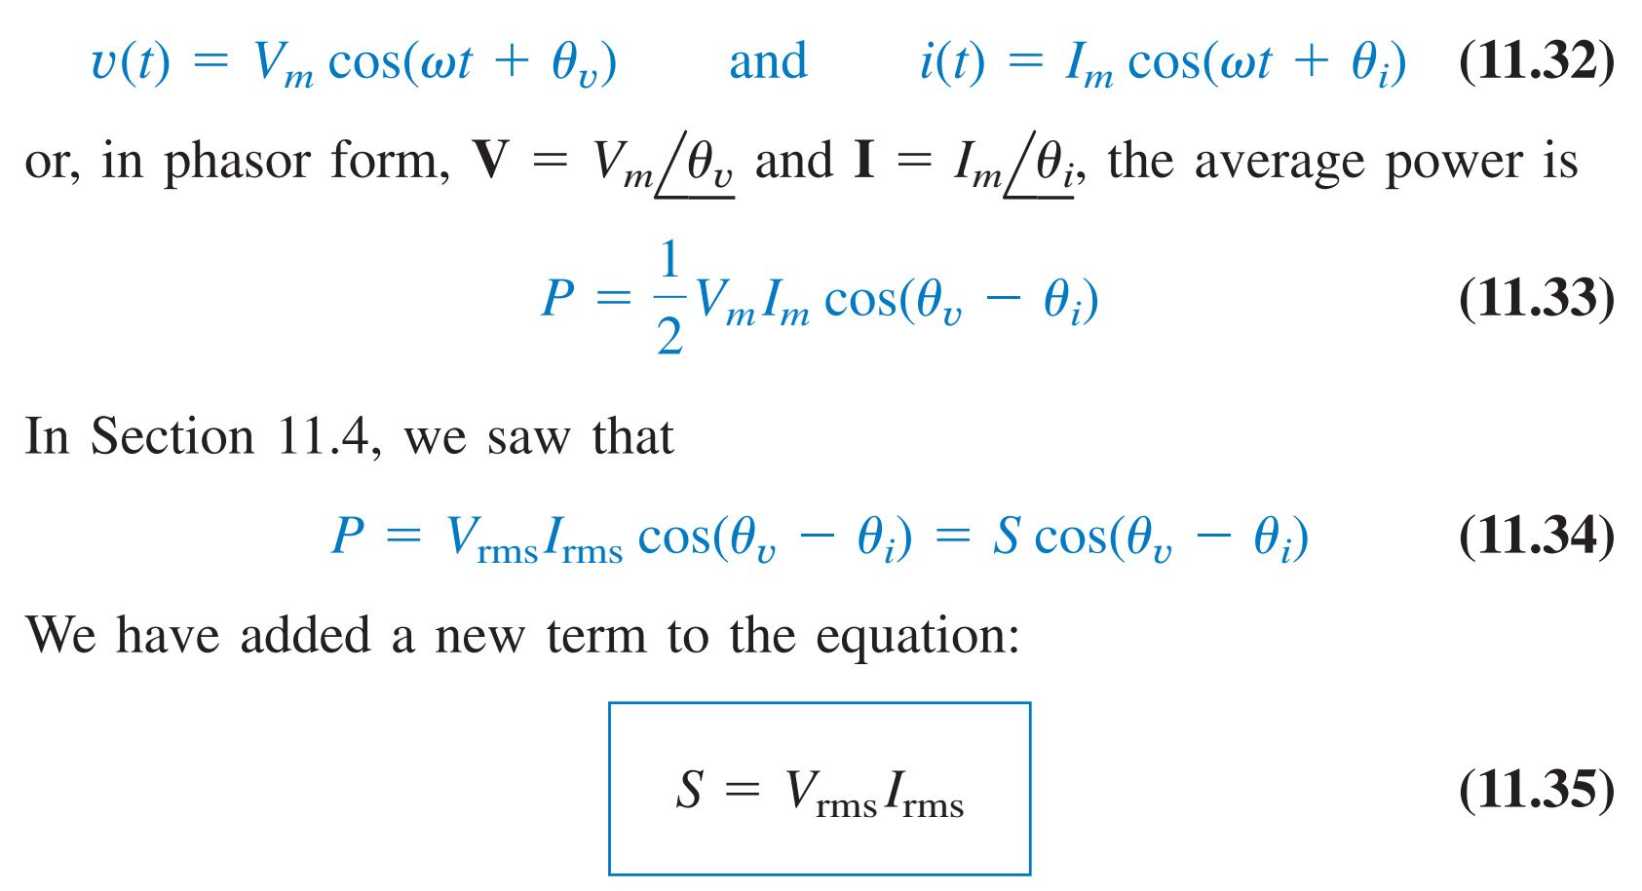
Apparent Power

Slide 4
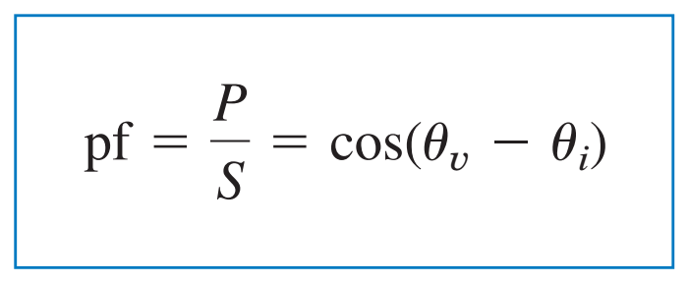


Power Factor

Slide 5

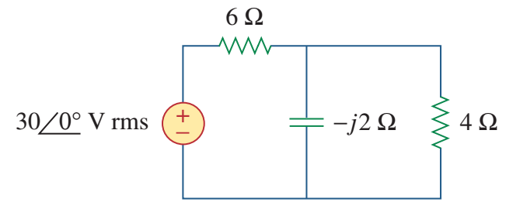
Problem

Slide 6
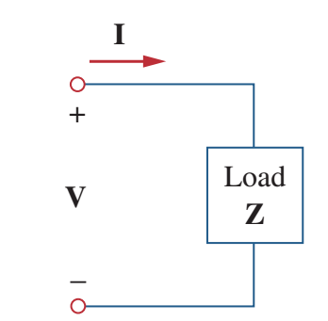
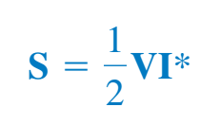

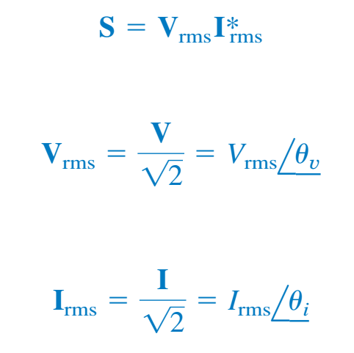
Complex power

Slide 7
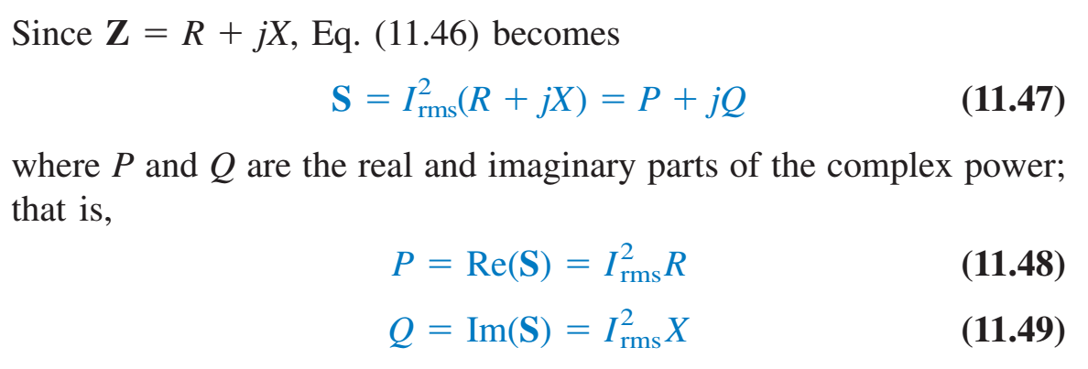

Complex power

Slide 8
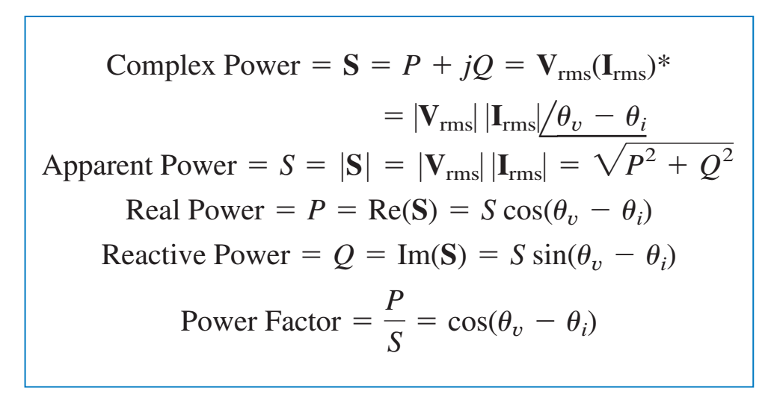
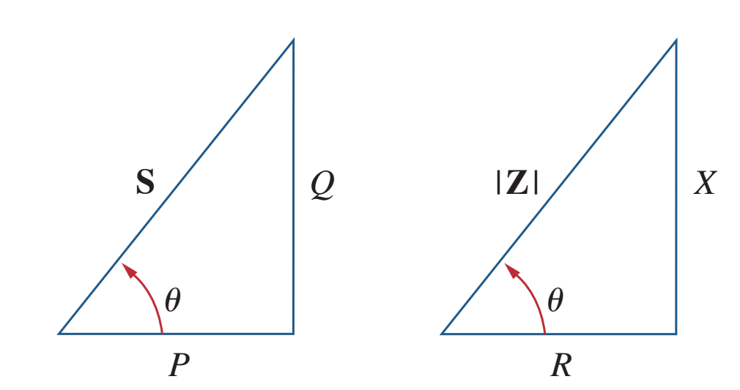
Complex power

Slide 9

Problem

Slide 10

Problem

Slide 11

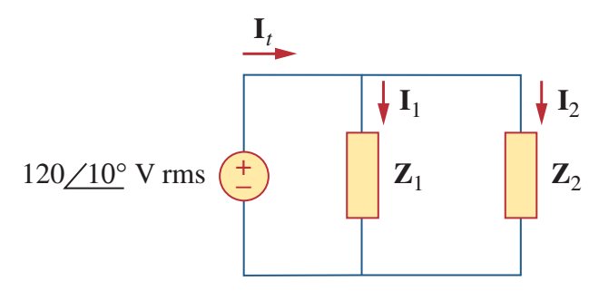
Problem

Slide 12

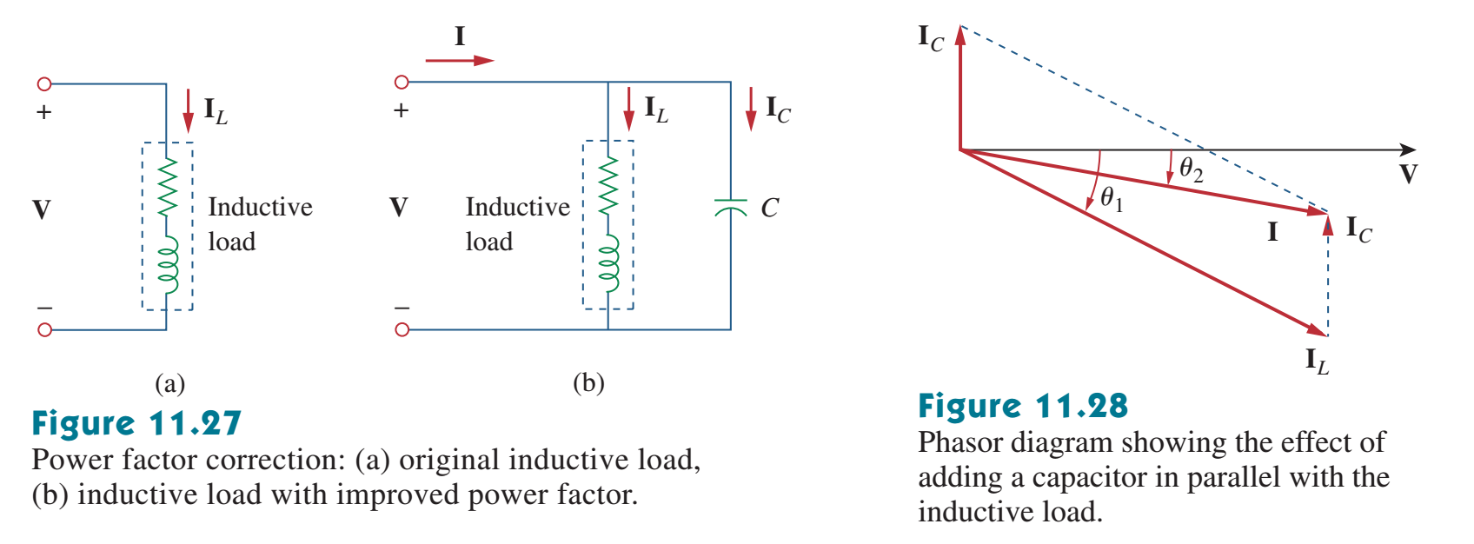
Power factor correction

Slide 13
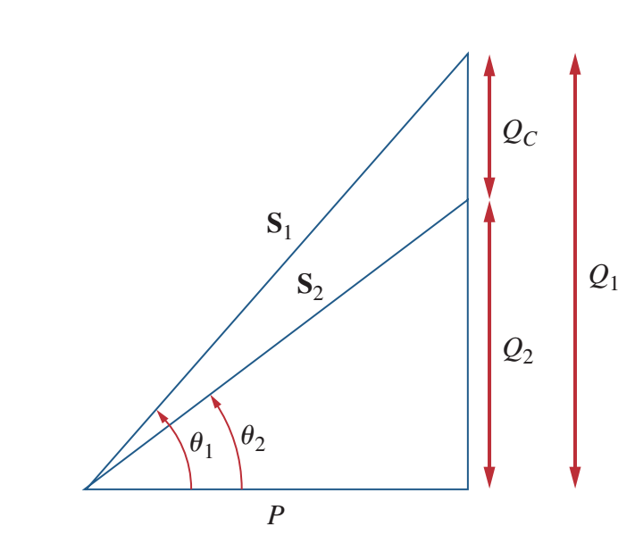

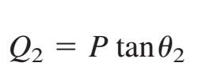


Power factor correction

Slide 14

Problem

Slide 15


